Slide 1
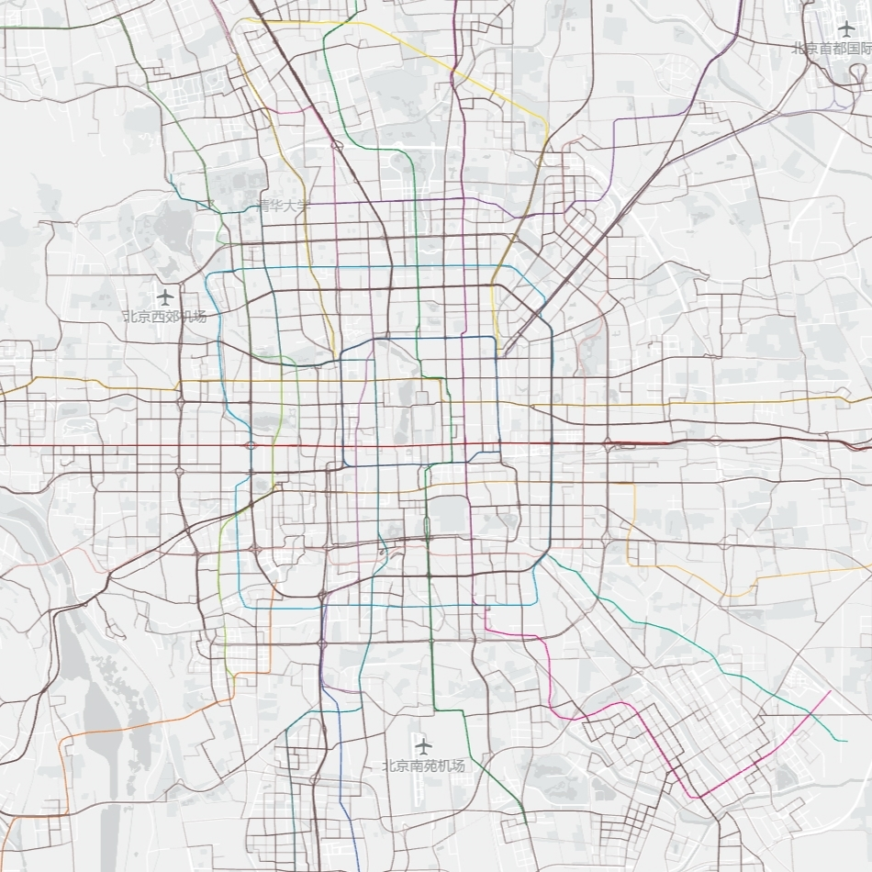

Comparison and Quantification of the Hierarchy of High-capacity Unimodal Public Transport Networks
Kelton Huang
Student nr. 5266688
October 12th, 2022

Slide 2
Outlines
Research questions
Methodology
Result examples
Outlooks
Notes:
The presentation will be given from the 4 parts:

Slide 3

01
Research questions

Slide 4
How to compare and quantify
high-capacity unimodal Public Transport Networks hierarchy
and the correlation with demographic or geographic information?

Slide 5
1. What is the high-capacity unimodal PTN’s hierarchy?
How a high-capacity unimodal PTN’s hierarchy is defined?
How do the networks reflect the hierarchy difference?
How to identify a high-hierarchy high-capacity unimodal PTN?
Notes:
Definitions are important. The entry point for the question is the morphology, thus the shapes of ideal hierarchy networks

Slide 6
2. How to compare the high-capacity unimodal PTN hierarchy of cities?
What indicators can interpret the necessary conditions of a high-hierarchy high-capacity unimodal PTN?
How to compare the high-capacity unimodal PTN hierarchy of cities by using the selected indicators?
Notes:
According to the identification of hierarchical structure, introducing the graph theory, topology
The comparison may not include the quantification… the extent can show the hierarchy or not

Slide 7
3. How to quantify the high-capacity unimodal PTN hierarchy of cities?
What properties of a high-hierarchy high-capacity unimodal PTN are quantified?
What indicators can quantify properties of a high-hierarchy high-capacity unimodal PTN?
How to quantify the high-capacity unimodal PTN hierarchy of cities with one hierarchy metric?

Slide 8
4. What is the correlation between high-capacity unimodal PTN with demographic or geographic information?
What demographic or geographic information is tested?
Whether the relationships are significant? Why?
Notes:
Introduced later

Slide 9

02
Methodology
9

Slide 10
What is the high-capacity
unimodal PTN’s hierarchy?

Slide 11
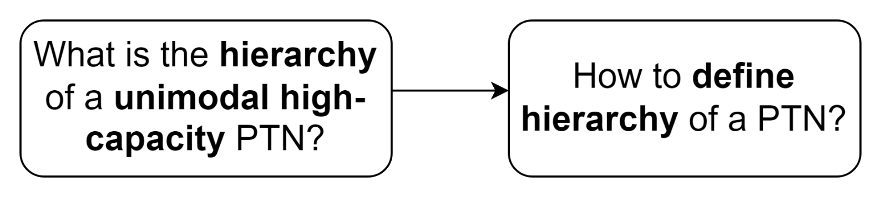
Methodology flow diagram
Notes:
First stage, how are the concepts defined?

Slide 12
1.1 What is the high-capacity unimodal PTN’s hierarchy?
How a high-capacity unimodal PTN’s hierarchy is defined?
The hierarchy is defined as an attribute of a network, which describes the extent the network’s shape performs a hierarchical structure.
Then, how is a hierarchical structure defined?
A hierarchical network structure has constituent vertices hierarchical organised, the vertices can be divided into levels that can be further subdivided into levels of levels, and so on to multiple scales. (Clauset et al., 2008)
The vertex number in levels exhibits a pyramid shape, the number of vertices is descending as the importance of the level goes higher.
Notes:
Clauset thought the vertices can be divided into sub-levels of levels indicating the hierarchical network structure. However, for transportation network, the relationship between different level vertices are not only containing and contained relationships, but also get the importance of vertices intra one level, connection strength of intra-level are higher than inter- level vertices.

Slide 13
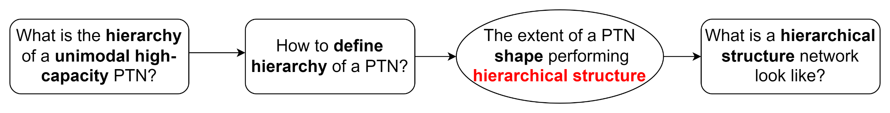
Methodology flow diagram
Notes:
After defining the hierarchy and hierarchical structure, but how to identify a hierarchical structure? How is a high-hierarchy network should look like?

Slide 14
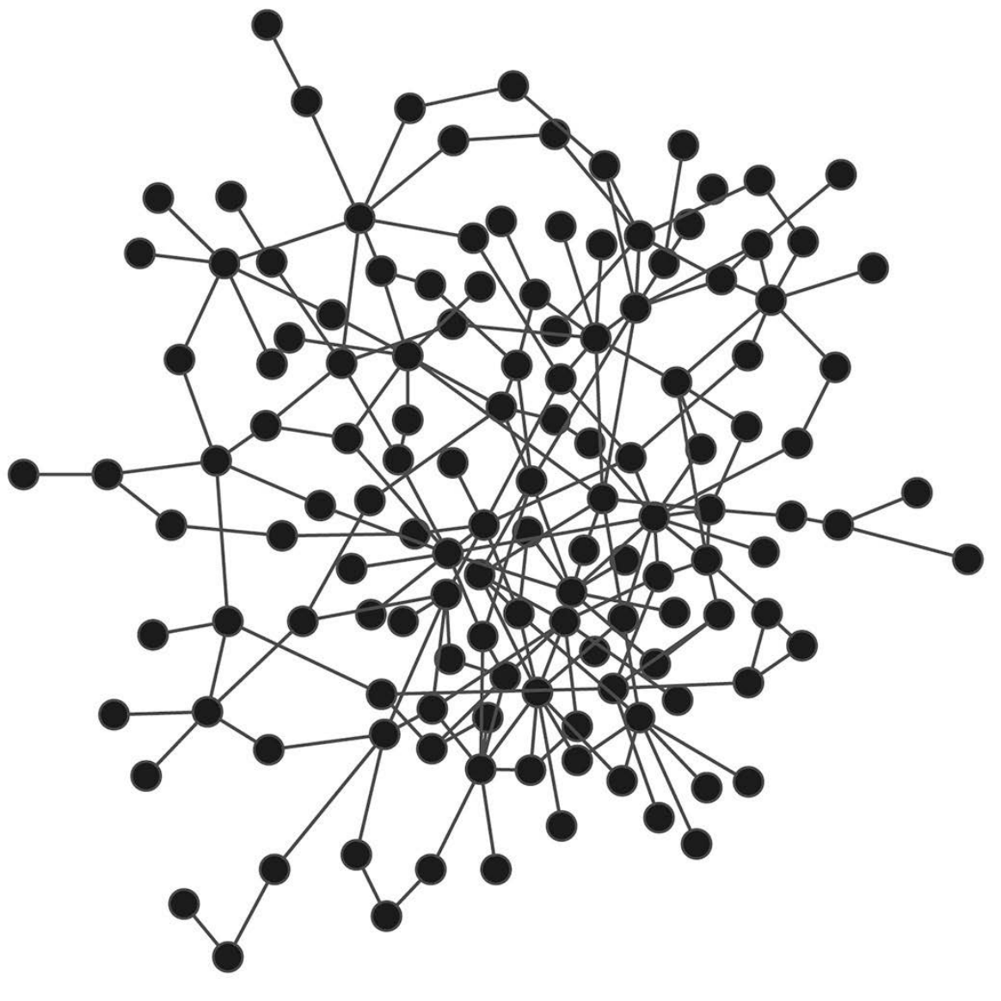
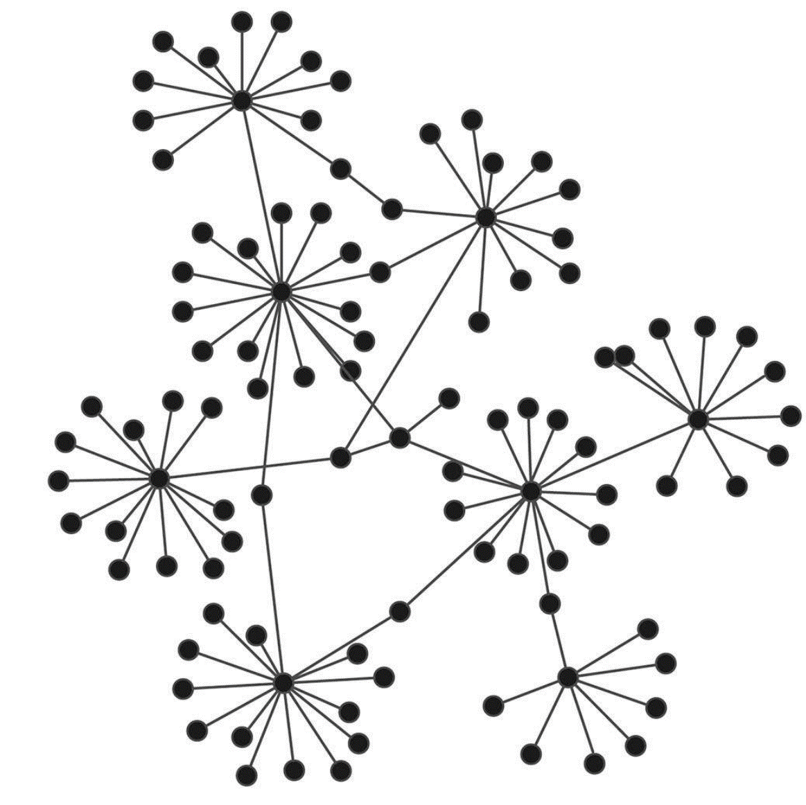
1.2 How the hierarchy difference is reflected in the networks?
Core/peripheral Network
Star-like Network
Notes:
The two structure of network are the ideal network structures with high-hierarchy.
The first is …..
The density in the core area is high, high connection, gradually descending to the peripheral area, the number of vertices raises with the less connection of vertices. High connect to high, low to low.
The second is star like…
There are multiple local hubs, connecting the many lower level vertices, hubs are connected with connectors.

Slide 15
1.3 Hierarchical structure identification
Necessary but insufficient conditions:
Scale-free network. Having a small number of high-importance vertices.
Showing either core/peripheral or star-like network organisation.
Descending vertex amount in each vertex level along with the increasing vertex level importance.

Slide 16
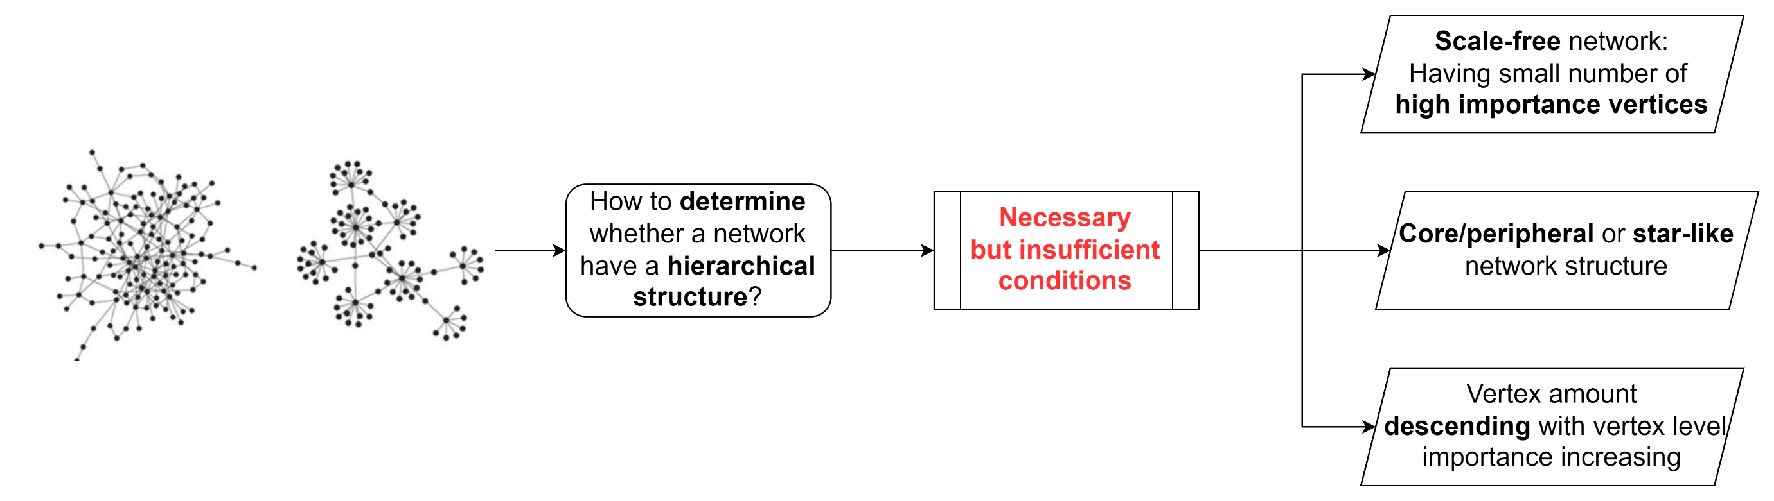
Methodology flow diagram

Slide 17
2. How to compare the high-capacity
unimodal PTN hierarchy of cities?

Slide 18
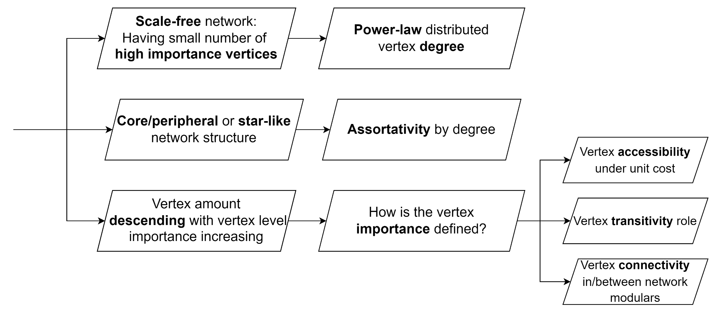
2.1 What indicators can interpret the necessary conditions of a high-hierarchy high-capacity unimodal PTN?

Slide 19
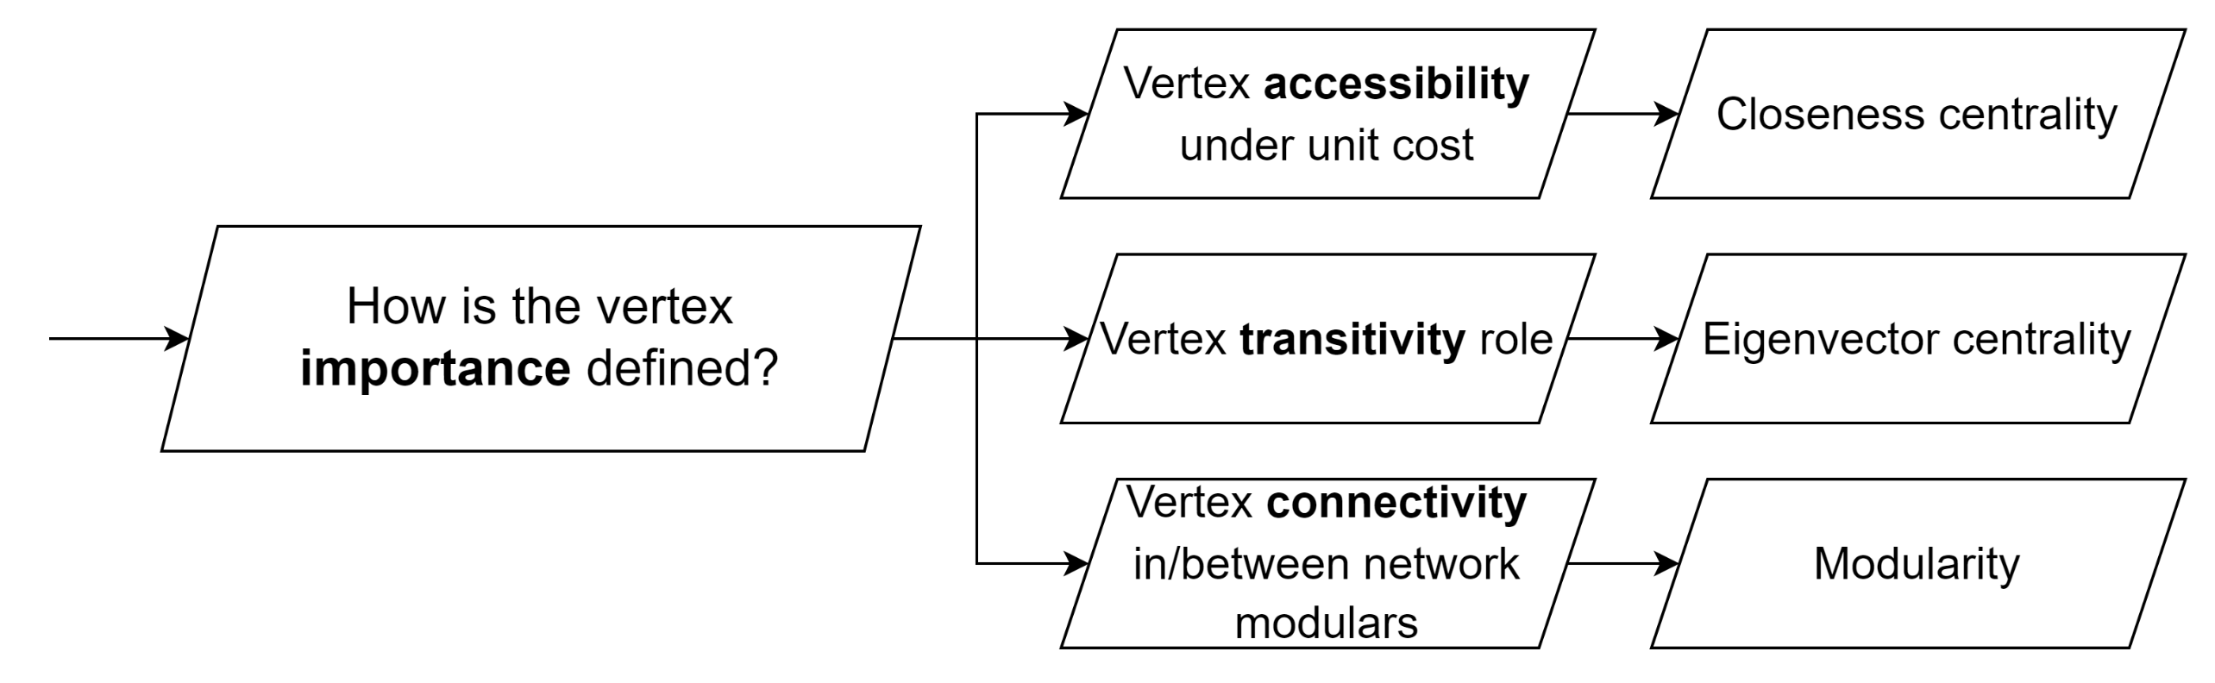
2.1 What indicators can interpret the necessary conditions of a high-hierarchy high-capacity unimodal PTN?

Slide 20
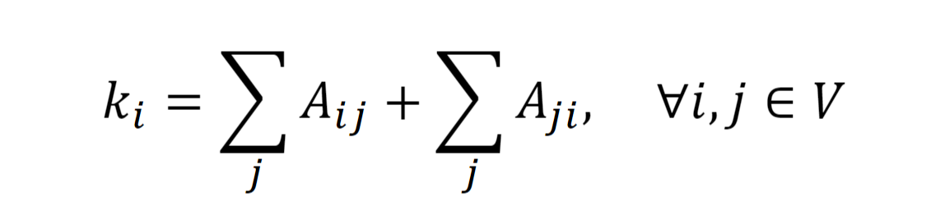
1) Degree
Defined as the number of edges a vertex connects to, describing the vertex’s ability to connect.
In scale-free networks, the vertex degree distribution should fit the power-law distribution.
In a bi-directed network, the degree equals the sum of in-degree and out-degree.

Slide 21
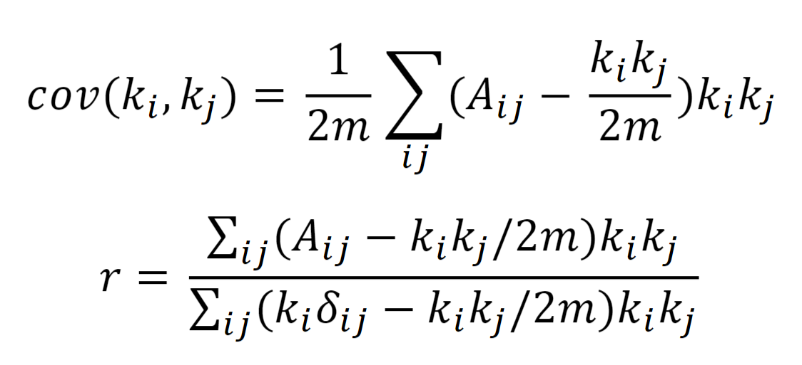
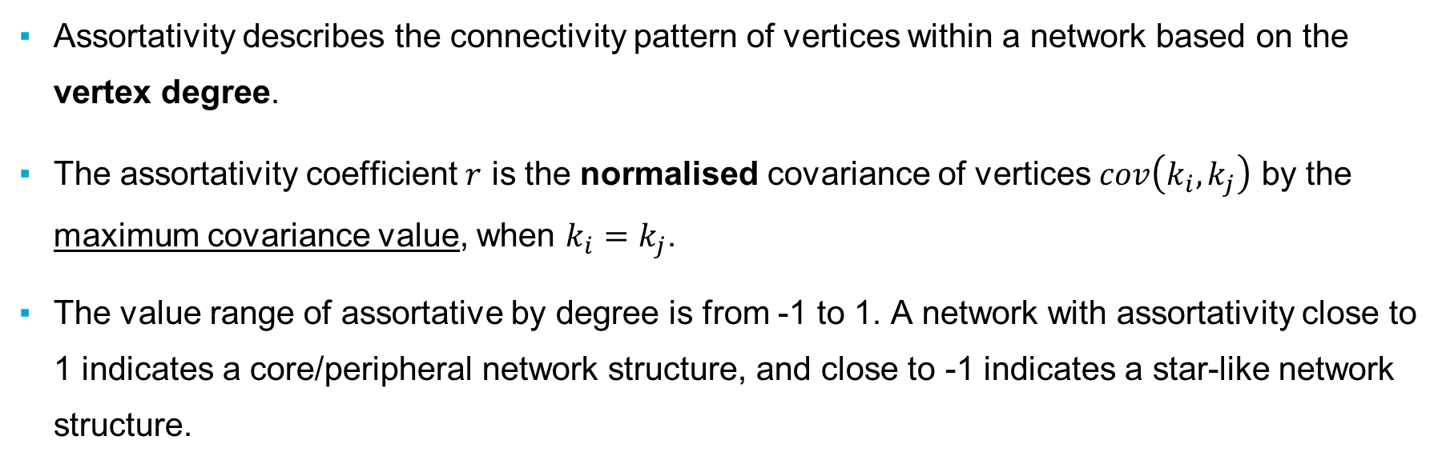
2) Assortativity mixing by degree
Assortativity describes the connectivity pattern of vertices within a network based on the vertex degree.
The assortativity coefficient $r$ is the normalised covariance of vertices $cov\left(k_{i},k_{j}\right)$ by the maximum covariance value, when $k_{i}=k_{j}$.
The value range of assortative by degree is from -1 to 1. A network with assortativity close to 1 indicates a core/peripheral network structure, and close to -1 indicates a star-like network structure.
Notes:
A_{ij} denotes the element of node i and j in the adjacency matrix. m denotes the total number of links in the network. k_i and k_j denote the degree of the two vertices. Simplified the equation of r \delta_{ij} is the Kronecker delta indicating whether there is a connection between node i and j, when there is a connection, \delta_{ij} equals 1, otherwise equals 0.
The value range of assortative by degree is from -1 to 1.
Close to 1, high to high, low to low
Close to -1, high to low

Slide 22
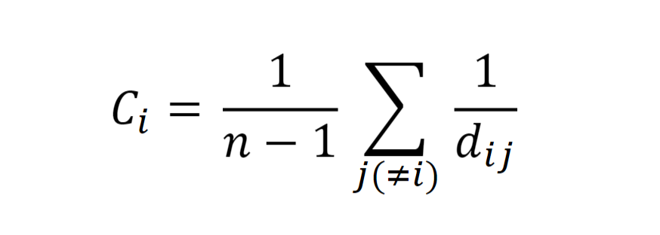
3) Closeness centrality
Defined as the harmonic mean value of geodesic distances 𝑑𝑖𝑗 from the vertex to all other vertices in the network, i.e., the average of the summation of all inverse weighted shortest path length.
Resistance of edges as weights, i.e. the average travel time of the edges.
Shows the accessibility of a vertex under a unit cost.
Notes:
Using the harmonic mean value is to avoid…
The higher the closeness centrality is , the easier a vertex can be reached.

Slide 23
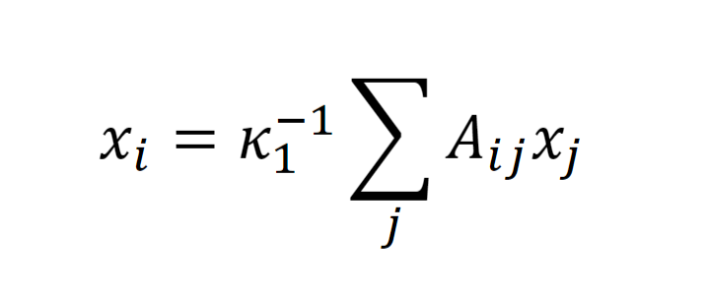
4) Eigenvector centrality
Eigenvector centrality is an indicator that originated from the importance of the neighbour vertices that a vertex directly connects with. Heuristic method until reaching convergence.
For bi-direct networks in this research, the eigenvector centrality only considers the in-edges of vertices to avoid duplication.
A higher eigenvector centrality value indicates a higher proportion in the high vertex levels of the connection. The importance of the vertices in the network connectivity is higher.
Notes:
1. Perron–Frobenius theorem: only when the eigenvector get the highest value, the centrality of the vertex can be shown.
at a real square matrix with positive entries has a unique largest real eigenvalue and that the corresponding eigenvector can be chosen to have strictly positive components.
2. x_i or x_j denote the eigenvector centrality of vertex i or j. \kappa_1 denotes the largest eigenvector value of the adjacency matrix A. A_{ij} is the element value of vertices i and j in the adjacency matrix.

Slide 24
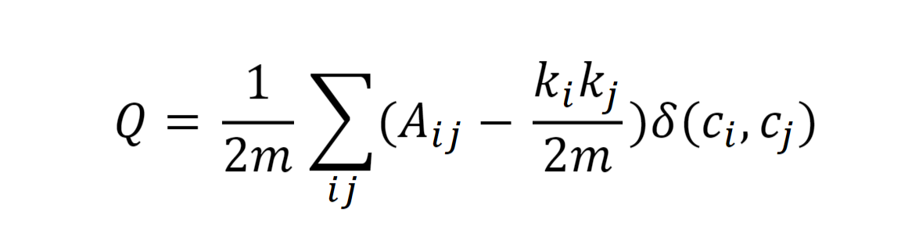
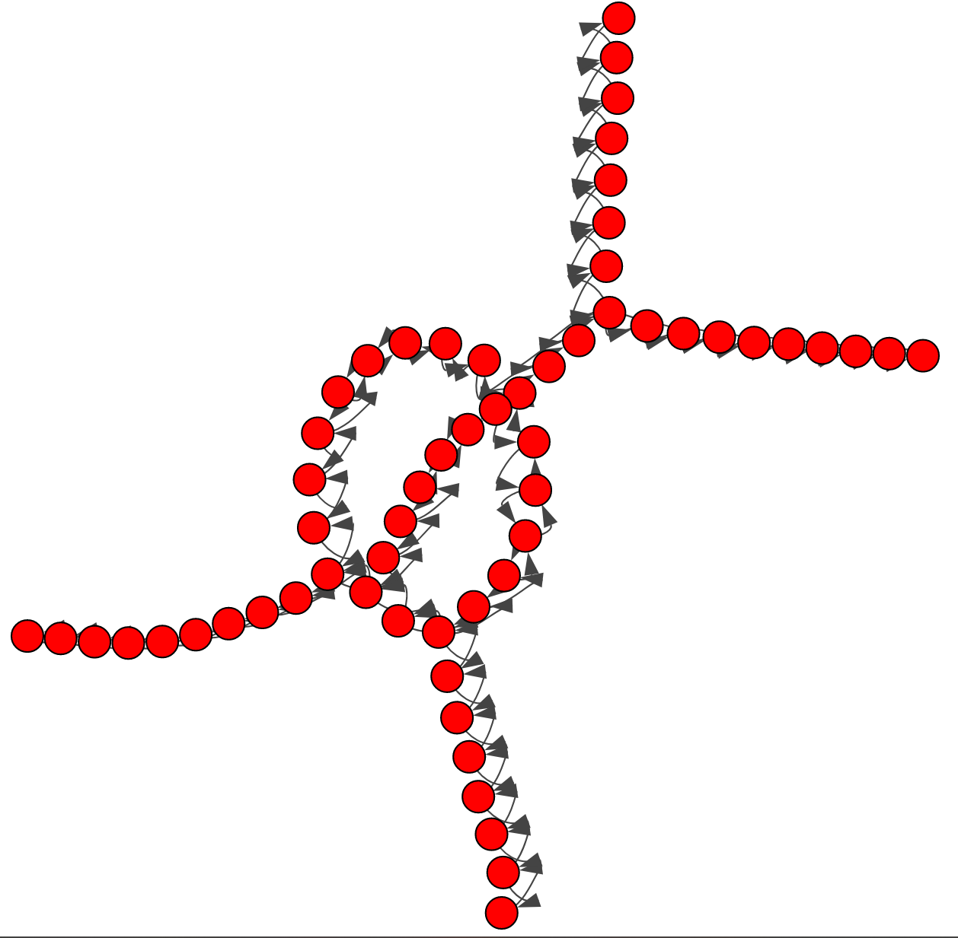
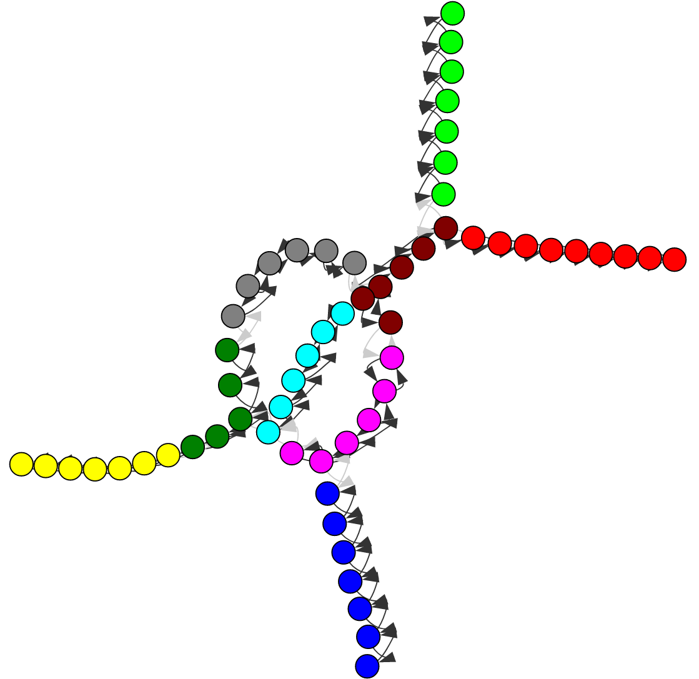
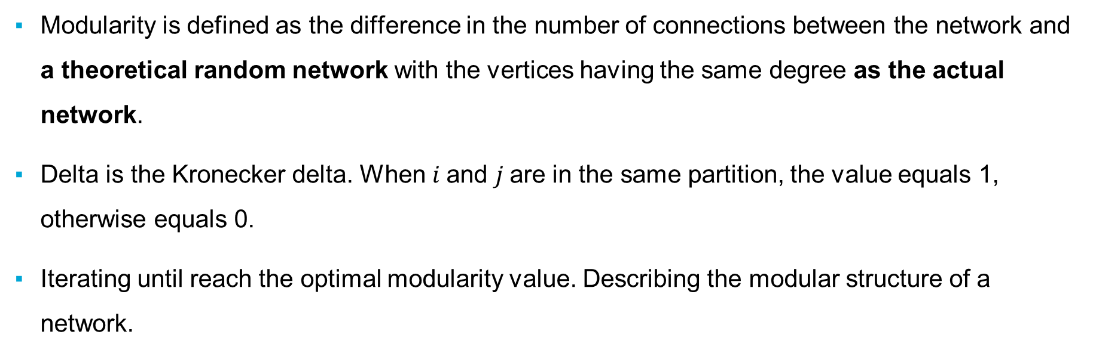
5) Optimal modularity based vertex role identification
Modularity is defined as the difference in the number of connections between the network and a theoretical random network with the vertices having the same degree as the actual network.
Delta is the Kronecker delta. When $i$and $j$are in the same partition, the value equals 1, otherwise equals 0.
Iterating until reach the optimal modularity value. Describing the modular structure of a network.

Slide 25
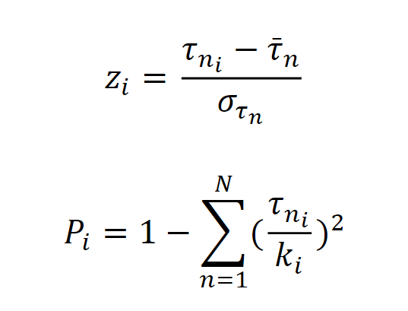
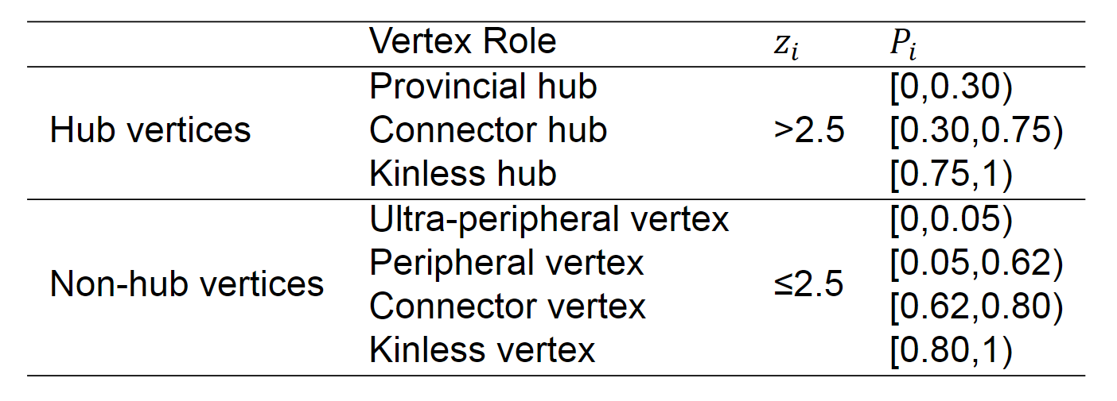
5) Optimal modularity based vertex role identification
Notes:
𝜏𝑛𝑖 stands for the number of edges connecting the 𝑖th vertex in partition 𝑛 to the other vertices in partition 𝑛. ̄ 𝜏𝑛 denotes the average of 𝜏𝑛𝑖 over all vertices in partition 𝑛. 𝜎𝜏𝑛 denotes the standard deviation of the intra-modular connectivity 𝑧𝑖 in partition 𝑛. For inter-modular connectivity 𝑃𝑖 , the 𝑁 denotes the total number of partitions in the network.

Slide 26
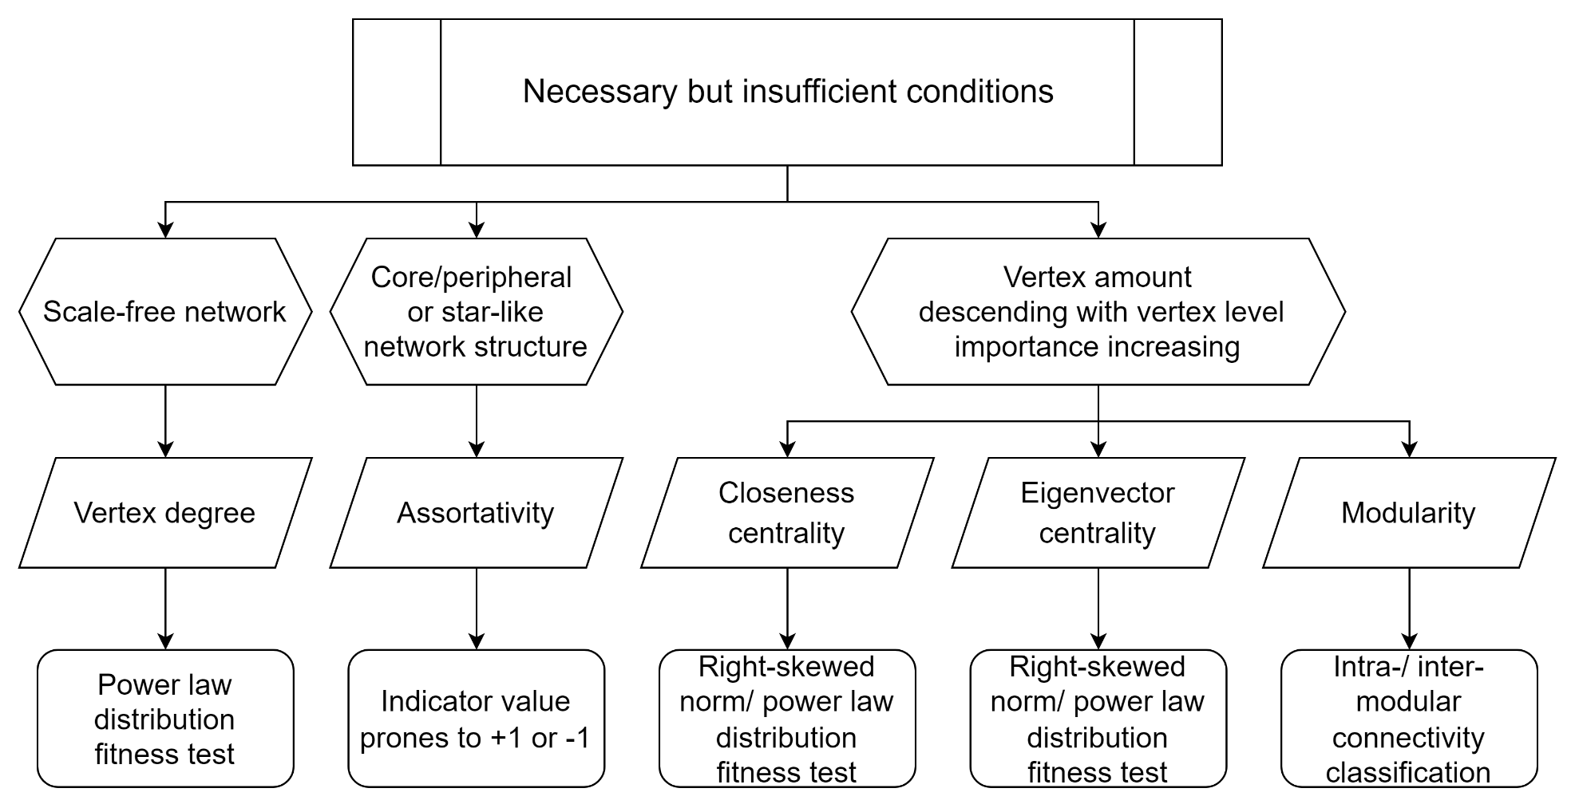
2.2 How to compare the high-capacity unimodal PTN hierarchy of cities by using the selected indicators?
L-space
Representation

Slide 27
2.2 Hierarchy comparison
Compare with the network-based indicator values
Value comparison
Mutual relations between indicators
Compare with different scales:
Mode-wise PTN hierarchy comparison (e.g. Metro, Tram and BRT)
Continent-wise PTN hierarchy comparison (e.g. Europe, South America, Asia)
Attribute/Correlation-wise PTN hierarchy comparison (e.g. Similar Size, Similar Population)

Slide 28
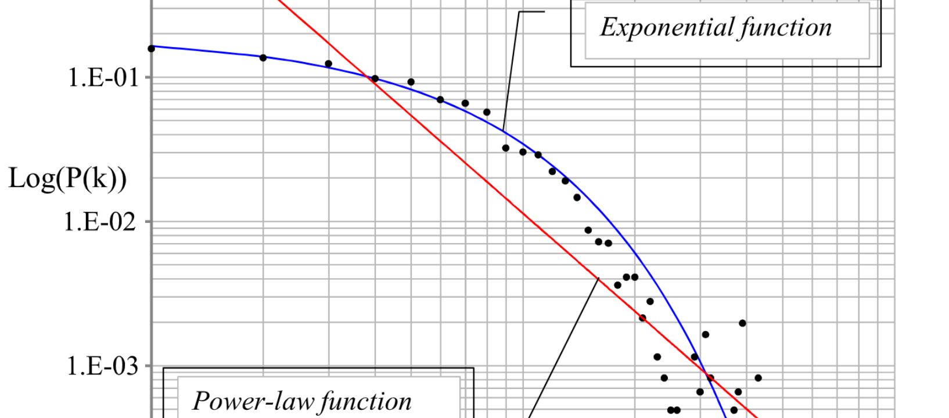
03
Result examples
28

Slide 29
Hierarchy comparison outline
Vertex-based indicator values → Network-level indicators
Degree → Power-law distribution goodness of fit
Assortativity (√)
Closeness centrality → Power-law/Right-skewed normal distribution goodness of fit
Eigenvector centrality → Power-law/Right-skewed normal distribution goodness of fit
Optimal modularity (√)
Optimal modularity-based vertex role identification → Validation reference for the indicator distributions
How well is the distribution fit the target distribution→ Is the network structure hierarchical?
Kolmogorov-Smirnov test, P-value as the goodness of fit

Slide 30
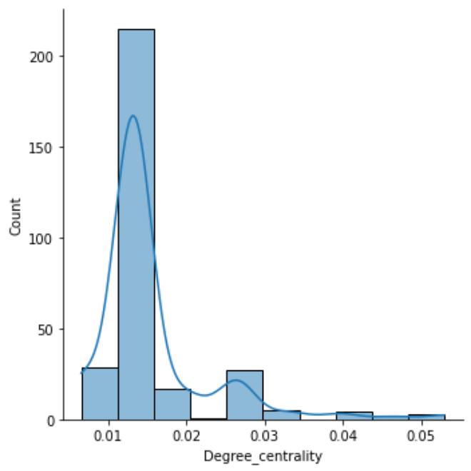
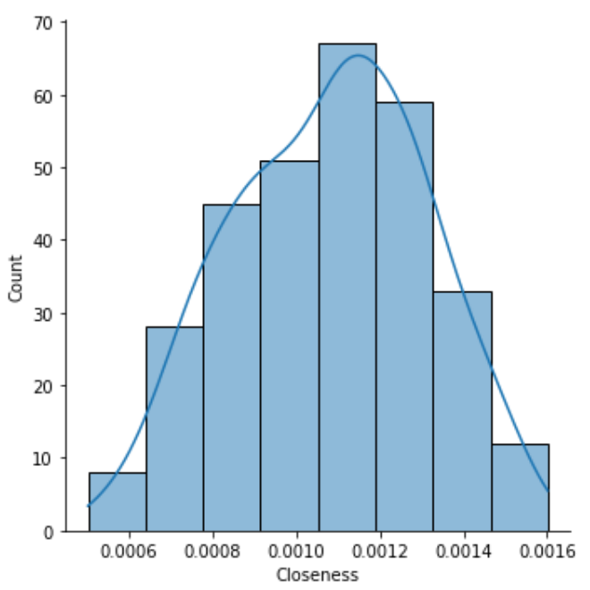
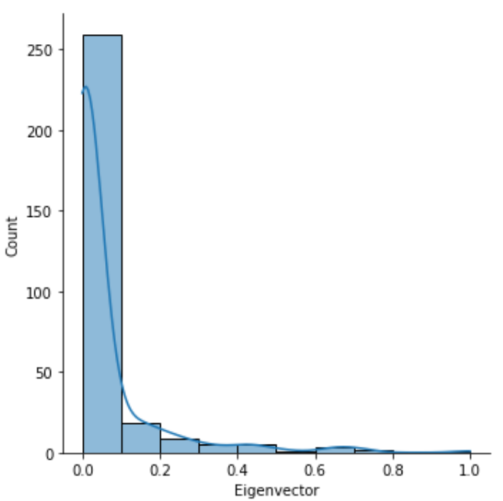
Vertex-based indicator histograms (with KDE curve)
 | Degree centrality | Closeness | Betweenness | Eigenvector | Z_i | P
0 | 0.013245 | 0.000991 | 0.026226 | 0.000848 | 0.134622 | 0.0
1 | 0.013245 | 0.000906 | 0.019736 | 0.000213 | 0.134622 | 0.0
2 | 0.013245 | 0.000845 | 0.013201 | 0.000055 | 0.134622 | 0.0
3 | 0.013245 | 0.000782 | 0.006623 | 0.000013 | 0.134622 | 0.0
4 | 0.006623 | 0.000734 | 0.000000 | 0.000002 | -0.875040 | 0.0
Degree
Closeness centrality
Eigenvector centrality

Slide 31
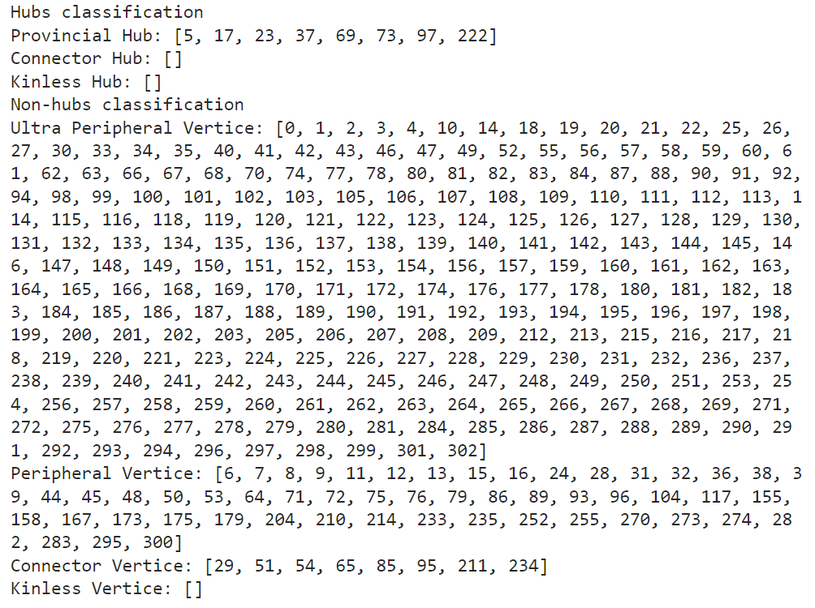
Optimal modularity-based vertex role identification
Vertex role identification results of Paris (Metro)

Slide 32
City high-capacity unimodal PTN hierarchy data overview (Network-based)
City | Continent | Mode | Degree fit Power-law | Assortativity | Closeness centrality fit Power-law | Closeness centrality fit Skewed normal | Eigenvector centrality fit Power-law | Eigenvector centrality fit Skewed normal
Budapest | Europe | Metro | 3.70E-18 | -1.42E-01 | 2.98E-26 | 3.11E-28 | 2.43E-07 | 9.96E-02
Bogota | South America | BRT | 1.15E-75 | 3.21E-01 | 3.97E-85 | 1.35E-87 | 1.39E-30 | 5.98E-06
Boston | North America | Metro | 2.68E-20 | 1.62E-01 | 1.31E-28 | 1.26E-30 | 1.55E-14 | 7.39E-01
Brussels | Europe | Metro | 6.30E-28 | -4.46E-03 | 9.69E-33 | 8.21E-35 | 5.70E-10 | 1.45E-02
Madrid | Europe | Metro | 1.22E-121 | 2.51E-01 | 8.45E-141 | 1.76E-143 | 8.41E-47 | 3.56E-17
London | Europe | Metro | 4.61E-111 | 1.55E-01 | 4.17E-156 | 4.17E-156 | 4.48E-129 | 3.59E-18
Paris | Europe | Metro | 3.28E-133 | 2.79E-03 | 2.32E-181 | 2.32E-181 | 1.58E-103 | 8.86E-09
Den Haag | Europe | Tram | 1.33E-102 | -9.31E-03 | 8.15E-129 | 1.85E-131 | 1.76E-105 | 2.75E-21
Amsterdam | Europe | Tram | 4.52E-74 | 7.00E-02 | 7.42E-108 | 2.01E-110 | 2.01E-110 | 2.01E-110
Rotterdam | Europe | Tram | 1.04E-62 | -6.09E-04 | 2.53E-86 | 8.50E-89 | 1.11E-54 | 9.26E-56
Utrecht | Europe | Tram | 4.55E-14 | 0.00E+00 | 1.09E-18 | 1.09E-18 | 5.33E-04 | 6.35E-01

Slide 33
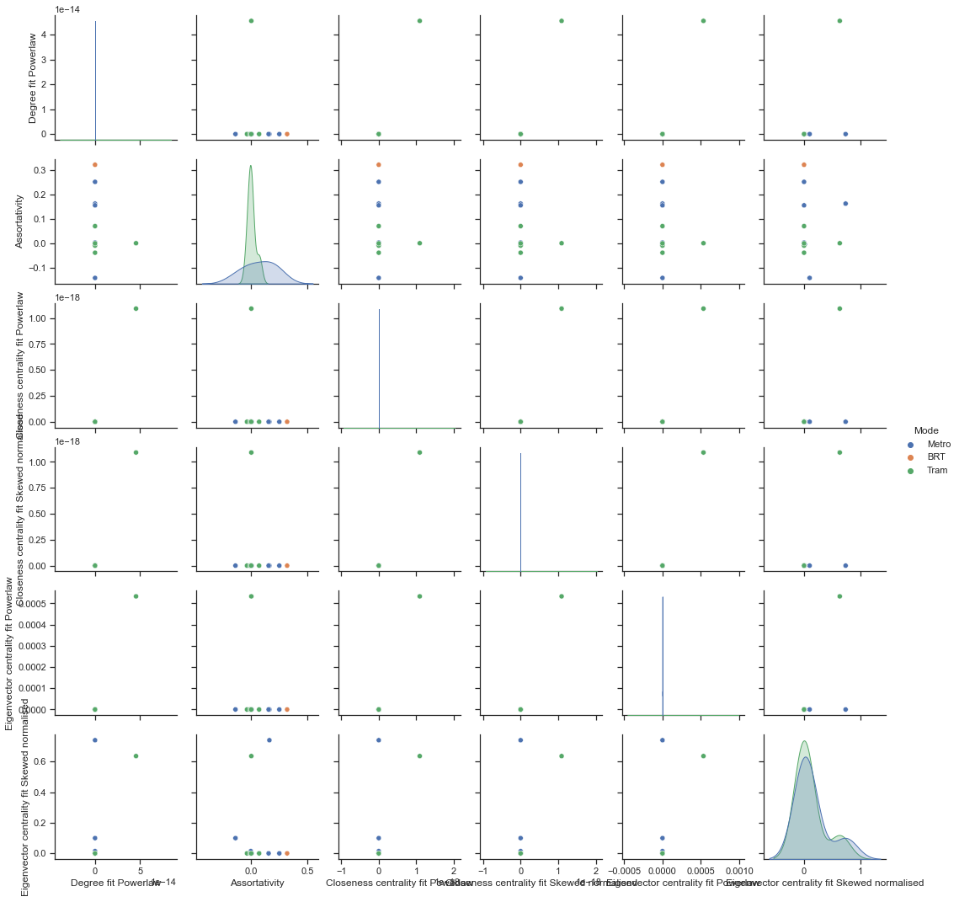
Indicators pair-plot

Slide 34

04
Outlooks

Slide 35
3. How to quantify the high-capacity unimodal PTN hierarchy of cities?
4. What is the correlation between high-capacity unimodal PTN with demographic or geographic information?

Slide 36
3. Hierarchy quantification
So far…
Capture the properties of high-hierarchy PTN, for example
Vertex centrality descending with the level decrease
Vertices in low levels have low accessibility
Vertex-based indicators distribution regression → Regression function scale parameters
Is the network structure hierarchical? How is the network structure hierarchical?
Introducing a new original metric for the quantification
Maybe multiple all the standardized network-based indicators
Maybe from the adjacency matrix perspective, like the assortativity coefficient
Final goal: city PTN hierarchy spectrum

Slide 37
4. Association with other information
Demographic information
Population
GDP
City role for the country (politic centre, economy centre)
Geographic information
City scale
Coastal or inland
Urban planning theory?

Slide 38
Q & A

Slide 39
Thank you for listening.
39

Slide 40
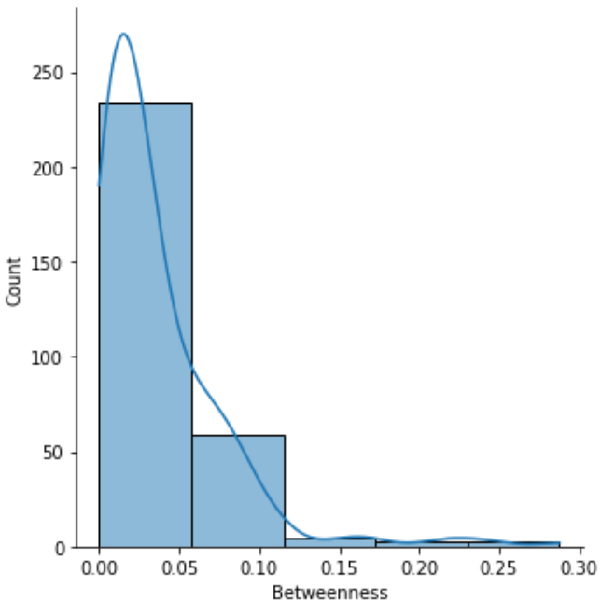
Betweenness centrality?

